Slide 1
TIME SERIES ANALYSIS
Unit 3-4-5-6

Slide 2




Differencing
The backward shift operator B is a useful notational device when working with time series lags:
(Some references use L for “lag” instead of B for “backshift”.)
In other words, B, operating on yt, has the effect of shifting the data back one period. Two applications of B to yt shifts the data back two periods:
For monthly data, if we wish to consider “the same month last year,” the notation is
The backward shift operator is convenient for describing the process of differencing. A first difference can be written as

Slide 3

Differencing
So a first difference can be represented by (1−B)(1−B). Similarly, if second-order differences have to be computed, then:
In general, a dth-order difference can be written as

Slide 4
Auto-Regression
In a multiple regression model, we forecast the variable of interest using a linear combination of predictors.
In an autoregression model, we forecast the variable of interest using a linear combination of past values of the variable.
The term autoregression indicates that it is a regression of the variable against itself.
Thus, an autoregressive model of order p can be written as
where εt is white noise
This is like a multiple regression but with lagged values of yt as predictors. We refer to this as an AR(p) model, an autoregressive model of order p.

Slide 5
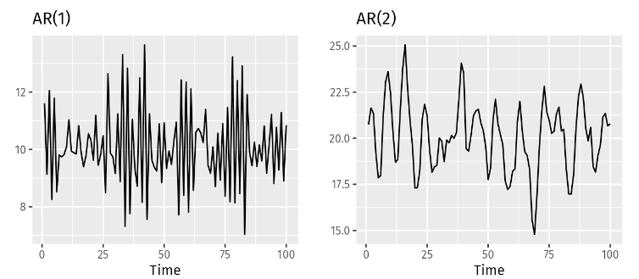

Auto-Regression
Autoregressive models are remarkably flexible at handling a wide range of different time series patterns.
The two series in Figure show series from an AR(1) model and an AR(2) model.
Changing the parameters ϕ1,…,ϕp results in different time series patterns.
The variance of the error term εt will only change the scale of the series, not the patterns.

Slide 6
Auto-Regression
For an AR(1) model:
when ϕ1=0 and c=0, yt is equivalent to white noise;
when ϕ1=1 and c=0, yt is equivalent to a random walk;
when ϕ1=1 and c≠0, yt is equivalent to a random walk with drift;
when ϕ1<0, yt tends to oscillate around the mean.
We normally restrict autoregressive models to stationary data, in which case some constraints on the values of the parameters are required.
For an AR(1) model: −1<ϕ1<1.
For an AR(2) model: −1<ϕ2<1, ϕ1+ϕ2<1, ϕ2−ϕ1<1.

Slide 7
Moving Average Models
Rather than using past values of the forecast variable in a regression, a moving average model uses past forecast errors in a regression-like model,
We refer to this as an MA(q) model,
Notice that each value of yt can be thought of as a weighted moving average of the past few forecast errors
However, moving average models should not be confused with the moving average smoothing
A moving average model is used for forecasting future values, while moving average smoothing is used for estimating the trend-cycle of past values.

Slide 8
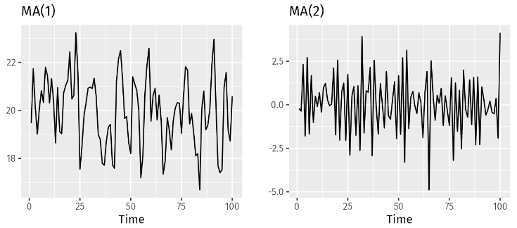

Moving Average Models
Figure shows some data from an MA(1) model and an MA(2) model.
Changing the parameters θ1,…,θq results in different time series patterns.
As with autoregressive models, the variance of the error term εt will only change the scale of the series, not the patterns.

Slide 9
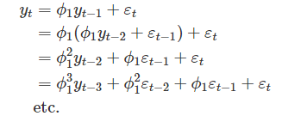

Moving Average Models
It is possible to write any stationary AR(p) model as an MA(∞) model. For example, using repeated substitution, we can demonstrate this for an AR(1) model:
provided −−1<ϕ1<1, the value of will get smaller as k gets larger. So eventually we obtain
an MA(∞) process.
The reverse result holds if we impose some constraints on the MA parameters. Then the MA model is called invertible. That is, we can write any invertible MA(q) process as an AR(∞) process.
The invertibility constraints for other models are similar to the stationarity constraints.

Slide 10
ARMA Models
The ARMA model is a combination of both AR and MA components.
An ARMA(p, q) model, where p is the number of lagged observations (AR part) and q is the number of lagged forecast errors (MA part), is represented as:
Determining the appropriate values for p and q is crucial for building an effective ARMA model. This can be done using the following methods:
Partial Autocorrelation Function (PACF):
  PACF is used to determine the order p of the AR model. It measures the correlation between observations at different lags, excluding the influence of intermediate lags.
  The order p is determined by the lag at which the PACF plot cuts off.
Autocorrelation Function (ACF):
  ACF is used to determine the order q of the MA model. It measures the correlation between observations at different lags.
  The order q is determined by the lag at which the ACF plot cuts off.

Slide 11
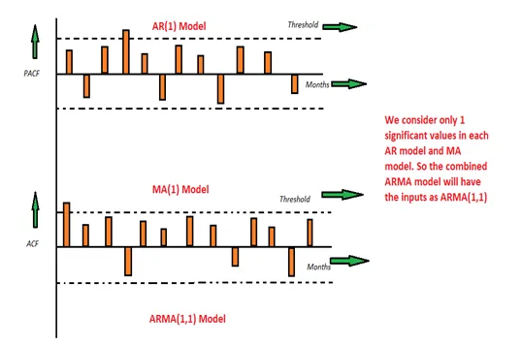
ARMA Models
Causality of a stationary time series indicates that the time series is dependent on past/lag values.
Invertibility refers to linear stationary process which behaves like infinite representation of autoregressive. In other word, this is the property that possessed by a moving average process. Invertibility solves non-uniqueness of autocorrelation function of moving average.

Slide 12
Non-seasonal ARIMA models
If we combine differencing with autoregression and a moving average model, we obtain a non-seasonal ARIMA model. ARIMA is an acronym for AutoRegressive Integrated Moving Average.
(9.1)
where y′t is the differenced series (it may have been differenced more than once).
The “predictors” on the right hand side include both lagged values of yt and lagged errors. We call this an ARIMA(p,d,q) model, where
p = | order of the autoregressive part;
d = | degree of first differencing involved;
q = | order of the moving average part.

Slide 13
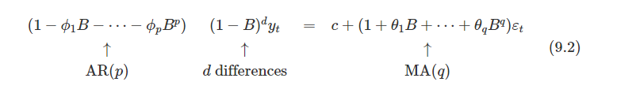
Non-seasonal ARIMA models
Special cases of ARIMA models.
White noise | ARIMA(0,0,0) with no constant
Random walk | ARIMA(0,1,0) with no constant
Random walk with drift | ARIMA(0,1,0) with a constant
Autoregression | ARIMA(p,0,0)
Moving average | ARIMA(0,0,q)
Once we start combining components in this way to form more complicated models, it is much easier to work with the backshift notation.

Slide 14
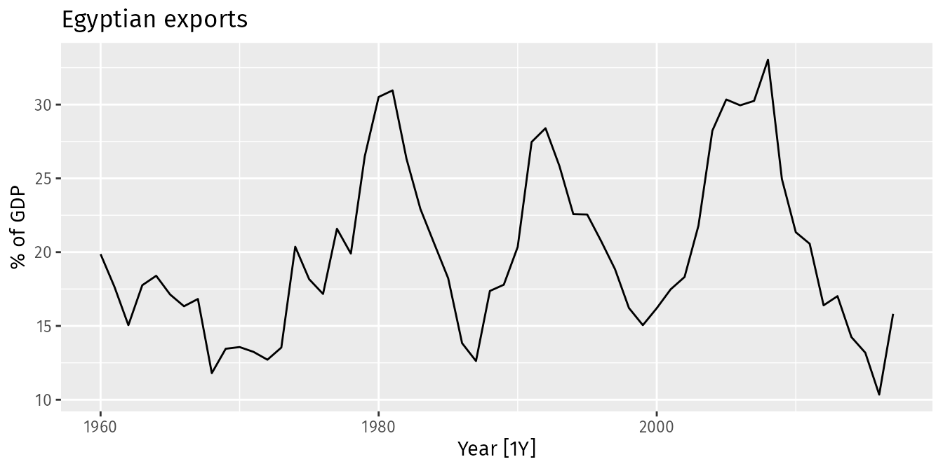
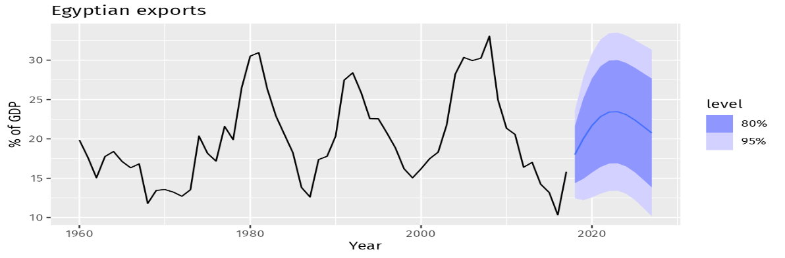
Non-seasonal ARIMA models
This is an ARIMA(2,0,1) model:
where εt is white noise with a standard deviation of 2.837=√8.046.
Forecasts from the model are shown in below Figure

Slide 15
Understanding ARIMA models
The constant c has an important effect on the long-term forecasts obtained from these models.
If c=0 and d=0, the long-term forecasts will go to zero.
If c=0 and d=1, the long-term forecasts will go to a non-zero constant.
If c=0 and d=2, the long-term forecasts will follow a straight line.
If c≠0 and d=0, the long-term forecasts will go to the mean of the data.
If c≠0 and d=1, the long-term forecasts will follow a straight line.
If c≠0 and d=2, the long-term forecasts will follow a quadratic trend.
The value of d also has an effect on the prediction intervals — the higher the value of d, the more rapidly the prediction intervals increase in size.
For d=0, the long-term forecast standard deviation will go to the standard deviation of the historical data, so the prediction intervals will all be essentially the same.
This behaviour is seen in forecasted Figure where d=0 and c≠0. In this figure, the prediction intervals are almost the same width for the last few forecast horizons, and the final point forecasts are close to the mean of the data.

Slide 16
ACF and PACF plots
ACF plot shows the autocorrelations which measure the relationship between yt and yt−k for different values of k.
Now if yt and yt−1 are correlated, then yt−1 and yt−2 must also be correlated.
However, then yt and yt−2 might be correlated, simply because they are both connected to yt−1, rather than because of any new information contained in yt−2 that could be used in forecasting yt.
To overcome this problem, we can use partial autocorrelations. These measure the relationship between yt and yt−k after removing the effects of lags 1,2,3,…,k−1.
So the first partial autocorrelation is identical to the first autocorrelation, because there is nothing between them to remove.
Each partial autocorrelation can be estimated as the last coefficient in an autoregressive model.
Specifically, αk, the kth partial autocorrelation coefficient, is equal to the estimate of ϕk in an AR(k) model.

Slide 17
ACF and PACF plots
If the data are from an ARIMA(p,d,0) or ARIMA(0,d,q) model, then the ACF and PACF plots can be helpful in determining the value of p or q.
If p and q are both positive, then the plots do not help in finding suitable values of p and q.
For AR(1) model
Autocorrelations exponentially decays
There is a single significant partial autocorrelation
The data may follow an ARIMA(p,d,0) model means AR(p) model if the ACF and PACF plots of the differenced data show the following patterns:
the ACF is exponentially decaying or sinusoidal;
there is a significant spike at lag p in the PACF, but none beyond lag p.

Slide 18
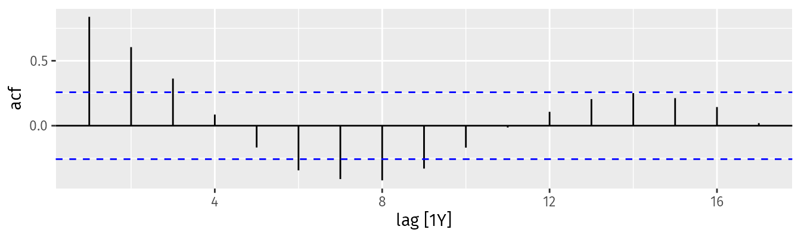

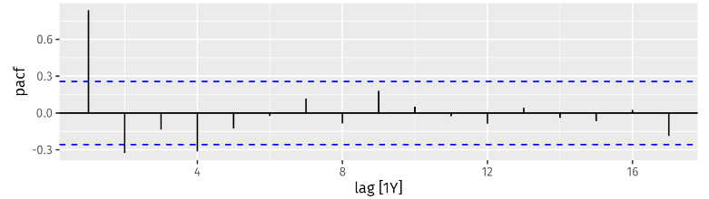
ACF and PACF plots
Calculate/Check Confidence Intervals:
For large sample sizes,
use ​ to set the significance bounds.
In figure, we see that there is a decaying sinusoidal pattern in the ACF and the PACF shows the last significant spike at lag 4. This is what you would expect from an ARIMA(4,0,0) model.

Slide 19
ACF and PACF plots
For MA(1) model
PACF is exponentially decaying
There is a single significant spike in ACF
The data may follow an ARIMA(0,d,q) model means MA(q) if the ACF and PACF plots of the differenced data show the following patterns:
the PACF is exponentially decaying or sinusoidal;
there is a significant spike at lag q in the ACF, but none beyond lag q.

Slide 20

Estimation and order selection
Once the model order has been identified (i.e., the values of p, d and q), we need to estimate the parameters c, ϕ1,…,ϕp, θ1,…,θq.
Maximum likelihood estimation (MLE) is a technique that finds the values of the parameters which maximise the probability of obtaining the data that we have observed.
For ARIMA, MLE is similar to the least squares estimates that would be obtained by minimizing

Slide 21





Order selection - Information Criteria
Akaike’s Information Criterion (AIC) is useful for determining the order of an ARIMA model. It can be written as
OR
where L is the likelihood of the data, k=1 if c≠0 and k=0 if c=0. Note that the last term in parentheses is the number of parameters in the model (including σ2, the variance of the residuals).
For ARIMA models, the corrected AIC can be written as
OR
and the Bayesian Information Criterion can be written as
n and T are same
Good models are obtained by minimising the AIC, AICc or BIC. Our preference is to use the AICc.

Slide 22

Calculating AICc
Fit the ARIMA Model: Suppose you fit an ARIMA(1,1,1) model to your time series data. After fitting the model, you obtain the following:
Number of observations n=100
Number of parameters k=3 (for ARIMA(1,1,1), this includes 1 AR parameter, 1 MA parameter, and 1 for the constant term)
Log-Likelihood of the model = -150.0
Calculate AIC: Using the log-likelihood and the number of parameters, compute the AIC:
AIC=−2⋅(−150.0)+2⋅3=300+6=306
Calculate AICc: Substitute the values into the AICc formula:

Slide 23
Order selection - Information Criteria
It is important to note that these information criteria tend not to be good guides to selecting the appropriate order of differencing (d) of a model, but only for selecting the values of p and q.
This is because the differencing changes the data on which the likelihood is computed, making the AIC values between models with different orders of differencing not comparable.
So we need to use some other approach to choose d, and then we can use the AICc to select p and q.

Slide 24
How does ARIMA works
When fitting an ARIMA model to a set of (non-seasonal) time series data, the following procedure provides a useful general approach.
Plot the data and identify any unusual observations.
If necessary, transform the data (using a Box-Cox transformation) to stabilize the variance.
If the data are non-stationary, take first differences of the data until the data are stationary.
Examine the ACF/PACF: Is an ARIMA(p,d,0) or ARIMA(0,d,q) model appropriate?
Try your chosen model(s), and use the AICc to search for a better model.
Check the residuals from your chosen model by plotting the ACF of the residuals, and doing a portmanteau test of the residuals. If they do not look like white noise, try a modified model.
Once the residuals look like white noise, calculate forecasts.

Slide 25
Hyndman-Khandakar algorithm
Hyndman-Khandakar algorithm for automatic ARIMA modelling
The number of differences 0≤d≤2 is determined using repeated KPSS tests.
The values of p and q are then chosen by minimising the AICc after differencing the data d times. Rather than considering every possible combination of p and q, the algorithm uses a stepwise search to traverse the model space.
a) Four initial models are fitted: ARIMA(0,d,0), ARIMA(2,d,2), ARIMA(1,d,0), ARIMA(0,d,1). A constant is included unless d=2. If d≤1, an additional model is also fitted: ARIMA(0,d,0) without a constant.
b) The best model (with the smallest AICc value) fitted in step (a) is set to be the “current model”.
c) Variations on the current model are considered: vary p and/or q from the current model by ±1; include/exclude c from the current model. The best model considered so far (either the current model or one of these variations) becomes the new current model.
d) Repeat Step 2(c) until no lower AICc can be found

Slide 26
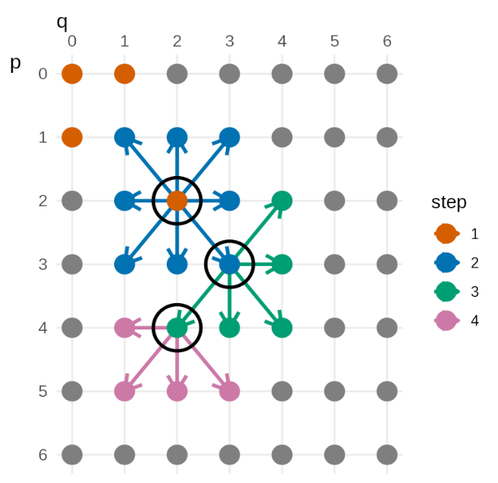
Hyndman-Khandakar algorithm
The grid covers combinations of ARMA(p,q) orders starting from the top-left corner with an ARMA(0,0), with the AR order increasing down the vertical axis, and the MA order increasing across the horizontal axis.
The orange cells show the initial set of models considered by the algorithm. In this example, the ARMA(2,2) model has the lowest AICc value amongst these models.
This is called the “current model” and is shown by the black circle.
The algorithm then searches over neighbouring models as shown by the blue arrows.
If a better model is found then this becomes the new “current model”.
In this example, the new “current model” is the ARMA(3,3) model.
The algorithm continues in this fashion until no better model can be found. In this example the model returned is an ARMA(4,2) model.
An illustrative example of the Hyndman-Khandakar stepwise search process
The default procedure will switch to a new “current model” as soon as a better model is identified, without going through all the neighbouring models. It may not give best results, but gives good results.

Slide 27
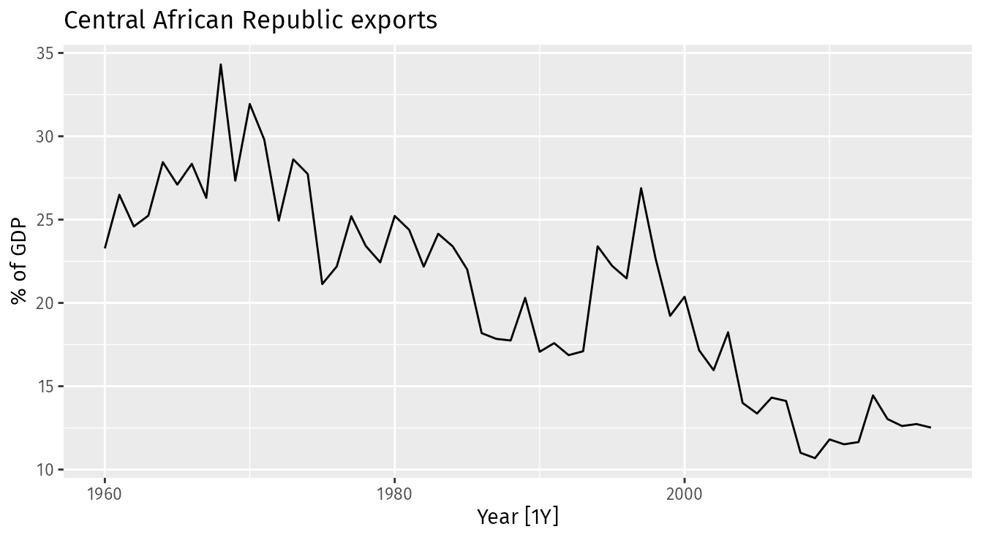
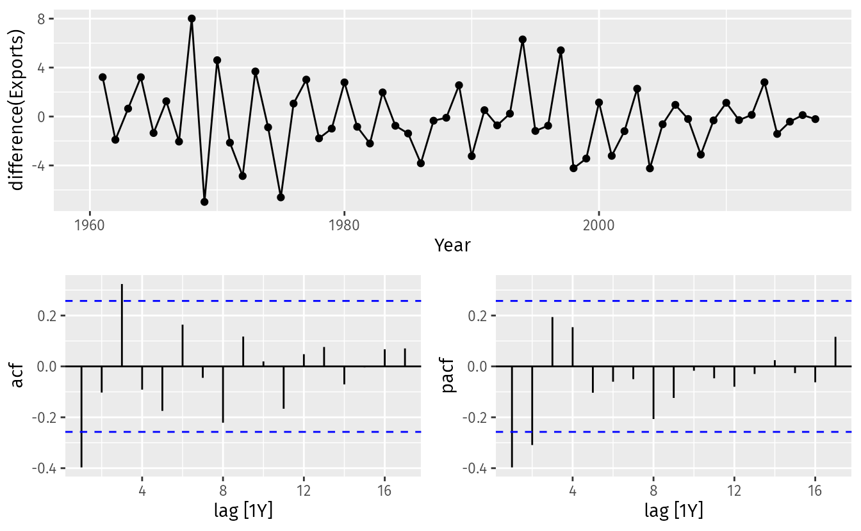
How does ARIMA works
The time plot shows some non-stationarity, with an overall decline.
To address the non-stationarity, we will take a first difference of the data.
The PACF shown in Figure 9.14 is suggestive of an AR(2) model; so an initial candidate model is an ARIMA(2,1,0).
The ACF suggests an MA(3) model; so an alternative candidate is an ARIMA(0,1,3).

Slide 28
How does ARIMA works
We fit both an ARIMA(2,1,0) and an ARIMA(0,1,3) model along with two automated model selections, one using the default stepwise procedure, and one working harder to search a larger model space.
The four models have almost identical AICc values. Of the models fitted, the full search has found that an ARIMA(3,1,0) gives the lowest AICc value,
#> Country `Model name` Orders
#> <fct> <chr> <model>
#> 1 Central African Republic arima210 <ARIMA(2,1,0)>
#> 2 Central African Republic arima013 <ARIMA(0,1,3)>
#> 3 Central African Republic stepwise <ARIMA(2,1,2)>
#> 4 Central African Republic search <ARIMA(3,1,0)>
#> .model sigma2 log_lik AIC AICc BIC
#> <chr> <dbl> <dbl> <dbl> <dbl> <dbl>
#> 1 search 6.52 -133. 274. 275. 282.
#> 2 arima210 6.71 -134. 275. 275. 281.
#> 3 arima013 6.54 -133. 274. 275. 282.
#> 4 stepwise 6.42 -132. 274. 275. 284.

Slide 29
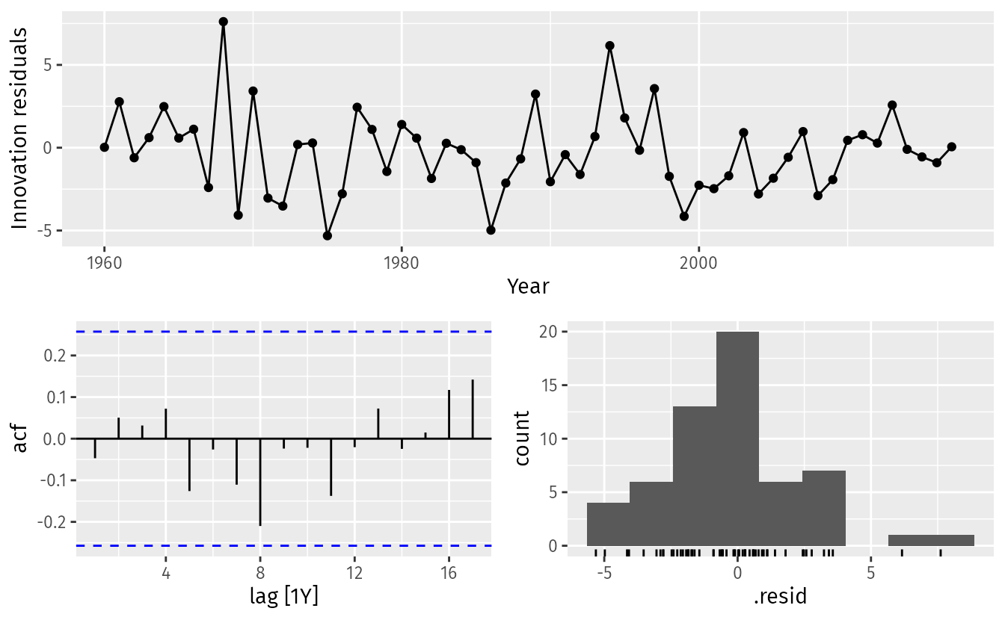
How does ARIMA works
The ACF plot of the residuals from the ARIMA(3,1,0) model shows that all autocorrelations are within the threshold limits, indicating that the residuals are behaving like white noise.
A portmanteau test (setting K=3) returns a large p-value, also suggesting that the residuals are white noise.
#> Country .model lb_stat lb_pvalue
#> <fct> <chr> <dbl> <dbl>
#> 1 Central African Republic search 5.75 0.569

Slide 30
The Portmanteau test, also known as the Ljung-Box test
The Portmanteau test, also known as the Ljung-Box test, is a statistical test used to determine whether there are significant autocorrelations in a time series.
It assesses the null hypothesis that the residuals from a fitted model (like an ARIMA model) are independently distributed.
The test computes a statistic based on the autocorrelations of the residuals up to a certain lag.
If the statistic is significantly large, it suggests that there are autocorrelations present.
Steps:
Fit a model to your time series data (e.g., ARIMA).
Calculate the residuals from the fitted model.
Conduct the Portmanteau test on these residuals to check for autocorrelation.
Interpretation:
A low p-value (commonly less than 0.05) indicates that you should reject the null hypothesis, suggesting that there are significant autocorrelations in the residuals.
A high p-value indicates that the residuals behave like white noise, and the model may be adequate.

Slide 31


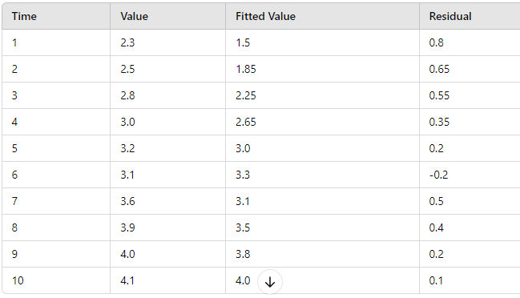
The Portmanteau test, also known as the Ljung-Box test
We’ll generate data, fit an ARIMA model, and perform the Ljung-Box test step by step, including calculations.
Assume we have the following synthetic time series data:
Let's say we fit an ARIMA(1, 1, 1) model to the data.
Calculation of Residuals
Assuming we fit the model and get the following estimated parameters:
AR(1) coefficient = 0.5
MA(1) coefficient = -0.3
Constant = 1.5
The fitted values and residuals might look like this:

Slide 32



The Portmanteau test, also known as the Ljung-Box test
We will use the residuals to perform the Ljung-Box test. For our example, we calculate the test statistic manually.
Step-by-Step Calculation:
Calculate Autocorrelations:
  Compute the sample autocorrelations rk​ for k=1,2,…,m where m is the number of lags.
  Let’s say we calculate r1,r2,r3,r4
  2. Calculate the Test Statistic:
Calculating Q:
Assume we find:
r1=0.2
r2=0.1
r3=0.05
r4=0.03
Number of observations n=10
The p-value can be derived from the chi-squared distribution with degrees of freedom equal to m.
Through software
p_value = 1 - chi2.cdf(Q, df=m) ----- here m=4
If we calculate it, we might find a p-value that is likely greater than 0.05, indicating that we do not reject the null hypothesis, suggesting no significant autocorrelation in the residuals.

Slide 33
Forecasts
Although we have calculated forecasts from the ARIMA models in our examples, we have not yet explained how they are obtained. Point forecasts can be calculated using the following three steps.
Expand the ARIMA equation so that yt is on the left hand side and all other terms are on the right.
Rewrite the equation by replacing t with T+h.
On the right hand side of the equation, replace future observations with their forecasts, future errors with zero, and past errors with the corresponding residuals.
Beginning with h=1, these steps are then repeated for h=2,3,… until all forecasts have been calculated.

Slide 34
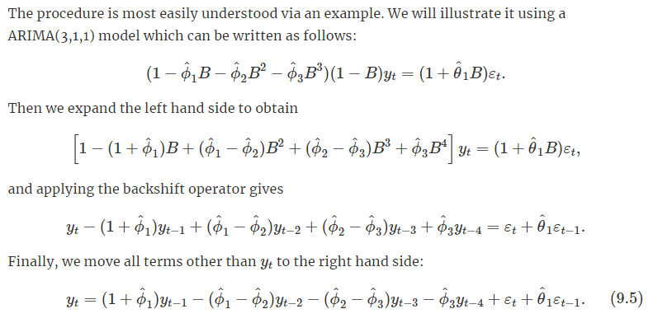
Forecasts
This completes the first step. While the equation now looks like an ARIMA(4,0,1), it is still the same ARIMA(3,1,1) model we started with. It cannot be considered an ARIMA(4,0,1) because the coefficients do not satisfy the stationarity conditions.

Slide 35
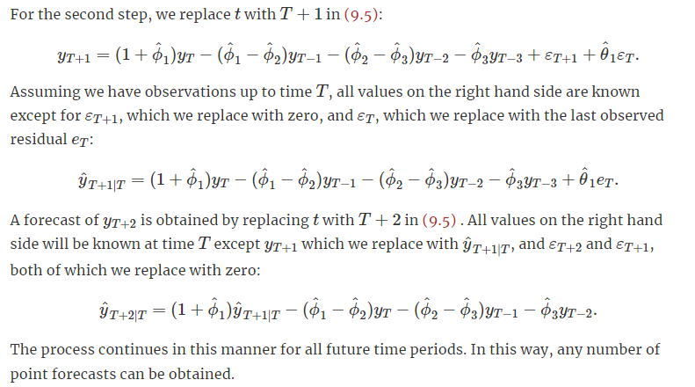
Forecasts

Slide 36
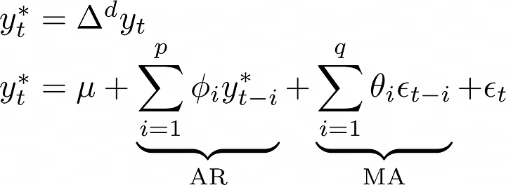
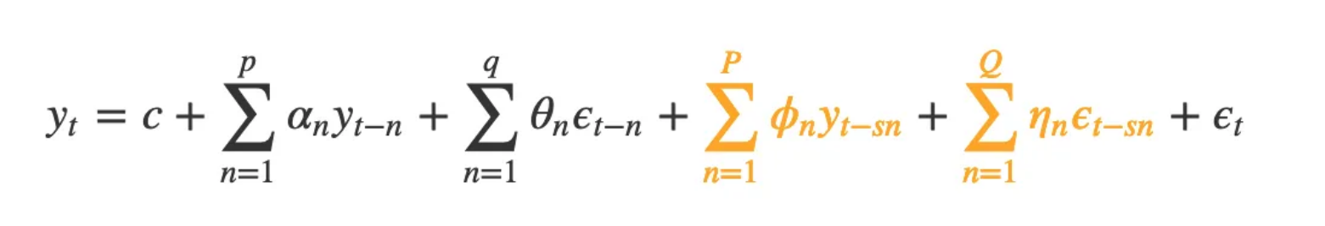
Seasonal ARIMA

Slide 37
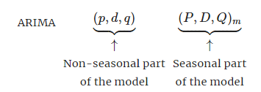
Seasonal ARIMA
A seasonal ARIMA model is formed by including additional seasonal terms in the ARIMA models we have seen so far. It is written as follows:
where m= the seasonal period (e.g., number of observations per year). We use uppercase notation for the seasonal parts of the model, and lowercase notation for the non-seasonal parts of the model.

Slide 38
Seasonal ARIMA
The seasonal part of the model consists of terms that are similar to the non-seasonal components of the model, but involve backshifts of the seasonal period.
For example, an ARIMA(1,1,1)(1,1,1)4 model (without a constant) is for quarterly data (m=4), and can be written as
The additional seasonal terms are simply multiplied by the non-seasonal terms.

Slide 39
Seasonal ARIMA
The seasonal part of an AR or MA model will be seen in the seasonal lags of the PACF and ACF.
For example, an ARIMA(0,0,0)(0,0,1)12 model will show:
a spike at lag 12 in the ACF but no other significant spikes;
exponential decay in the seasonal lags of the PACF (i.e., at lags 12, 24, 36, …).
Similarly, an ARIMA(0,0,0)(1,0,0)12 model will show:
exponential decay in the seasonal lags of the ACF;
a single significant spike at lag 12 in the PACF.
In considering the appropriate seasonal orders for a seasonal ARIMA model, restrict attention to the seasonal lags.

Slide 40
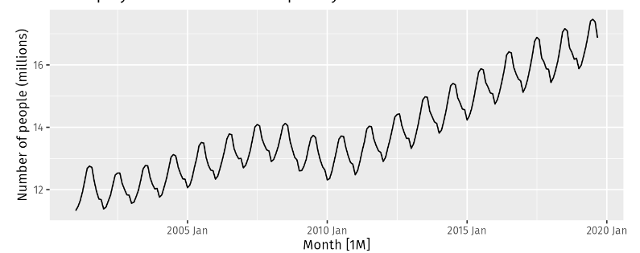
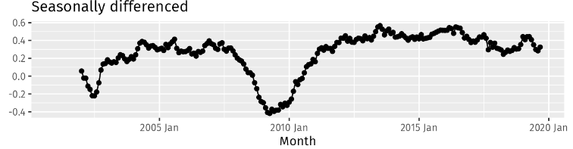
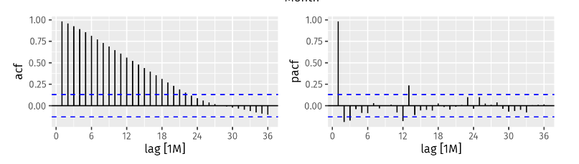
Seasonal ARIMA
The data are clearly non-stationary, with strong seasonality and a nonlinear trend, so we will first take a seasonal difference.
The seasonally differenced data are shown

Slide 41
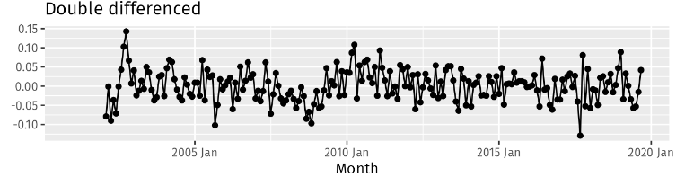
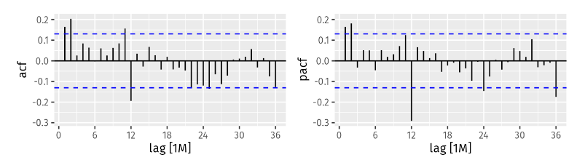
Seasonal ARIMA
Our aim now is to find an appropriate ARIMA model based on the ACF and PACF shown in Figure.
The significant spike at lag 2 in the ACF suggests a non-seasonal MA(2) component. The significant spike at lag 12 in the ACF suggests a seasonal MA(1) component.
Consequently, we begin with an ARIMA(0,1,2)(0,1,1)12 model, indicating a first difference, a seasonal difference, and non-seasonal MA(2) and seasonal MA(1) component.
If we had started with the PACF, we may have selected an ARIMA(2,1,0)(0,1,1)12 model — using the PACF to select the non-seasonal part of the model and the ACF to select the seasonal part of the model

Slide 42
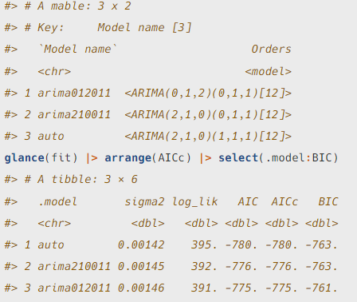
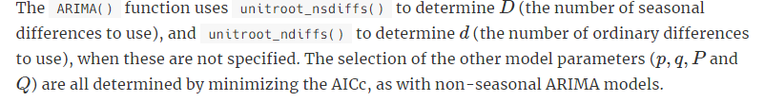
Seasonal ARIMA

Slide 43
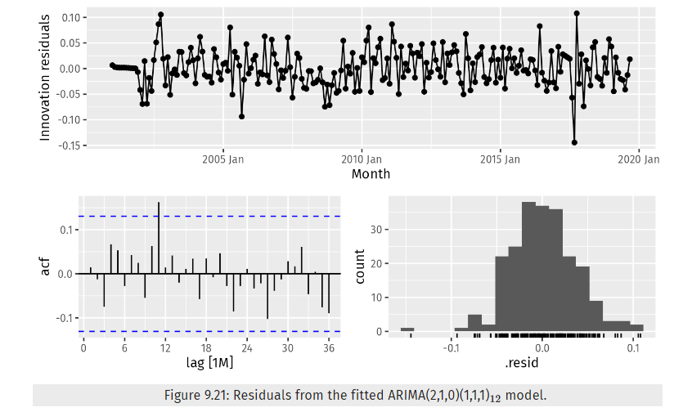

Seasonal ARIMA
The residuals for the best model are shown
One small but significant spike (at lag 11) out of 36 is still consistent with white noise. To be sure, we use a Ljung-Box test
The large p-value confirms that the residuals are similar to white noise.

Slide 44


Regression with ARIMA errors
we considered regression models of the form
where yt is a linear function of the k predictor variables (x1,t,…,xk,t), and εt is usually assumed to be an uncorrelated error term (i.e., it is white noise).
Here, we will allow the errors from a regression to contain autocorrelation.
To emphasise this change in perspective, we will replace εt with ηt in the equation. The error series ηt is assumed to follow an ARIMA model.
if ηt follows an ARIMA(1,1,1) model, we can write
where εt is a white noise series.
The error from the regression model, which we denote by ηt, and the error from the ARIMA model, which we denote by εt. Only the ARIMA model errors are assumed to be white noise.

Slide 45
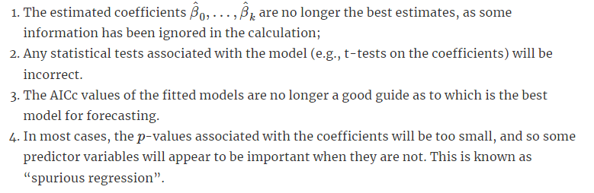
Regression with ARIMA errors
When we estimate the parameters from the model, we need to minimise the sum of squared εt values.
If we minimise the sum of squared ηt values instead then several problems arise.

Slide 46
Regression with ARIMA errors
An important consideration when estimating a regression with ARMA errors is that all of the variables in the model must first be stationary.
Thus, we first have to check that yt and all of the predictors (x1,t,…,xk,t) appear to be stationary.
If we estimate the model when any of these are non-stationary, the estimated coefficients will not be consistent estimates (and therefore may not be meaningful).
We therefore first difference the non-stationary variables in the model.
It is common to difference all of the variables if any of them need differencing.

Slide 47

Regression with ARIMA errors
If all of the variables in the model are stationary, then we only need to consider an ARMA process for the errors.
A regression model with ARIMA errors is equivalent to a regression model in differences with ARMA errors.
if the above regression model with ARIMA(1,1,1) errors is differenced we obtain the model

Slide 48

Regression with ARIMA errors
This is equivalent to the model
where ηt is an ARIMA(1,1,0) error.
The constant term disappears due to the differencing.
The final model will be expressed in terms of the original variables, even if it has been estimated using differenced variables.
The AICc is calculated for the final model, and this value can be used to determine the best predictors.
the procedure should be repeated for all subsets of predictors to be considered, and the model with the lowest AICc value selected.

Slide 49
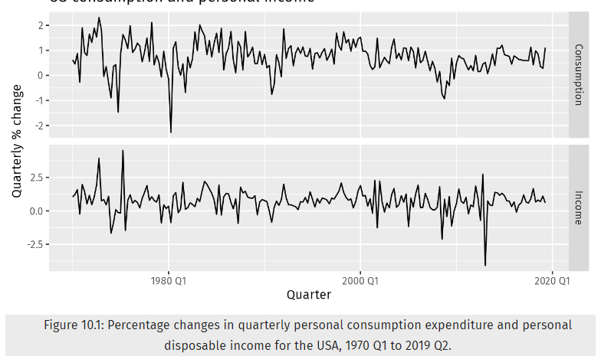

Regression with ARIMA errors
The data are clearly already stationary
The fitted model is

Slide 50
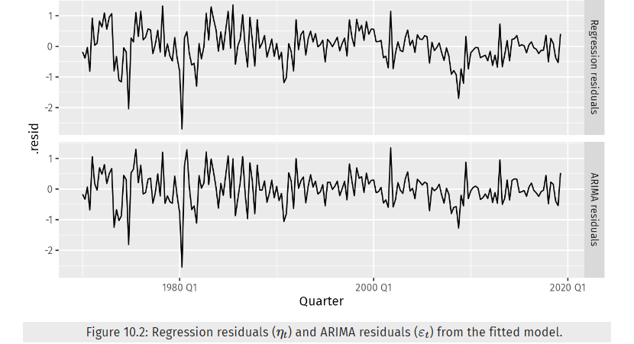
Regression with ARIMA errors
We can recover estimates of both the ηt and εt series using the residulas() function
It is the ARIMA estimated errors (the innovation residuals) that should resemble a white noise series.

Slide 51
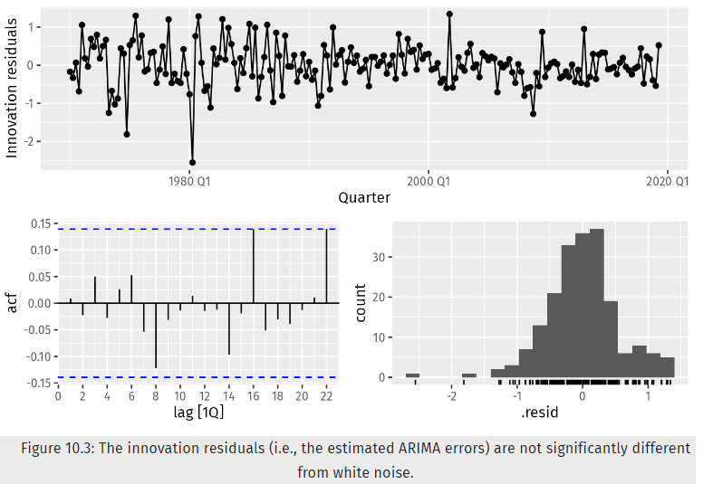
Regression with ARIMA errors

Slide 52
Information criteria
It is important to note that these information criteria tend not to be good guides to selecting the appropriate order of differencing (d) of a model, but only for selecting the values of p and q.
This is because the differencing changes the data on which the likelihood is computed, making the AIC values between models with different orders of differencing not comparable.
So, we need to use some other approach to choose d, and then we can use the AICc to select p and q.

Slide 53
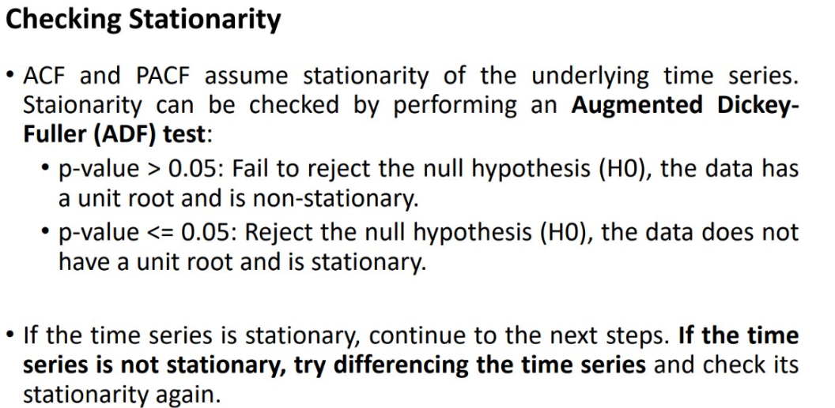
ADF Test for checking Stationarity and selection of parameter d

Slide 54
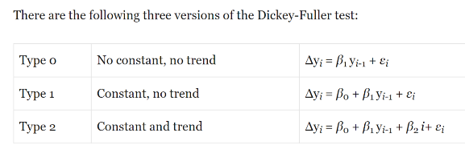
ADF Test Regression Equation

Slide 55
Example – spx data
date | spx | Lag1 dely | Fisrt Diff | lag1FirstDiff
07-01-1994 | 469.9
10-01-1994 | 475.27 | 469.9 | 5.37
11-01-1994 | 474.13 | 475.27 | -1.14 | 5.37
12-01-1994 | 474.17 | 474.13 | 0.04 | -1.14
13-01-1994 | 472.47 | 474.17 | -1.7 | 0.04
14-01-1994 | 474.91 | 472.47 | 2.44 | -1.7
17-01-1994 | 473.3 | 474.91 | -1.61 | 2.44
18-01-1994 | 474.25 | 473.3 | 0.95 | -1.61
19-01-1994 | 474.3 | 474.25 | 0.05 | 0.95
20-01-1994 | 474.98 | 474.3 | 0.68 | 0.05
21-01-1994 | 474.72 | 474.98 | -0.26 | 0.68
24-01-1994 | 471.97 | 474.72 | -2.75 | -0.26
25-01-1994 | 470.92 | 471.97 | -1.05 | -2.75
26-01-1994 | 473.2 | 470.92 | 2.28 | -1.05
27-01-1994 | 477.05 | 473.2 | 3.85 | 2.28
date | spx | Lag1 | lag1FirstDiff | Fisrt Diff
11-01-1994 | 474.13 | 475.27 | 5.37 | -1.14
12-01-1994 | 474.17 | 474.13 | -1.14 | 0.04
13-01-1994 | 472.47 | 474.17 | 0.04 | -1.7
14-01-1994 | 474.91 | 472.47 | -1.7 | 2.44
17-01-1994 | 473.3 | 474.91 | 2.44 | -1.61
18-01-1994 | 474.25 | 473.3 | -1.61 | 0.95
19-01-1994 | 474.3 | 474.25 | 0.95 | 0.05
20-01-1994 | 474.98 | 474.3 | 0.05 | 0.68
21-01-1994 | 474.72 | 474.98 | 0.68 | -0.26
24-01-1994 | 471.97 | 474.72 | -0.26 | -2.75
25-01-1994 | 470.92 | 471.97 | -2.75 | -1.05
26-01-1994 | 473.2 | 470.92 | -1.05 | 2.28
27-01-1994 | 477.05 | 473.2 | 2.28 | 3.85

Slide 56
Model type 1
SUMMARY OUTPUT
Regression Statistics
Multiple R | 0.026784
R Square | 0.000717
Adjusted R Square | 0.000518
Standard Error | 13.2425
Observations | 5014
ANOVA
 | df | SS | MS | F | Significance F
Regression | 1 | 630.9724 | 630.9724 | 3.598077 | 0.057904
Residual | 5012 | 878923.3 | 175.3638
Total | 5013 | 879554.2
 | Coefficients | Standard Error | t Stat | P-value | Lower 95% | Upper 95% | Lower 95.0% | Upper 95.0%
Intercept | 1.54073 | 0.722816 | 2.131567 | 0.033091 | 0.123695 | 2.957764 | 0.123695 | 2.957764
Lag1 | -0.00121 | 0.00064 | -1.89686 | 0.057904 | -0.00247 | 4.07E-05 | -0.00247 | 4.07E-05

Slide 57
Model type 2
SUMMARY OUTPUT
Regression Statistics
Multiple R | 0.073218
R Square | 0.005361
Adjusted R Square | 0.004964
Standard Error | 13.21301
Observations | 5014
ANOVA
 | df | SS | MS | F | Significance F
Regression | 2 | 4715.206 | 2357.603 | 13.50414 | 1.42E-06
Residual | 5011 | 874839 | 174.5837
Total | 5013 | 879554.2
 | Coefficients | Standard Error | t Stat | P-value | Lower 95% | Upper 95% | Lower 95.0% | Upper 95.0%
Intercept | 1.494096 | 0.721271 | 2.071477 | 0.038365 | 0.08009 | 2.908102 | 0.08009 | 2.908102
Lag1 | -0.00116 | 0.000638 | -1.81271 | 0.069937 | -0.00241 | 9.43E-05 | -0.00241 | 9.43E-05
lag1FirstDiff | -0.06816 | 0.014091 | -4.83675 | 1.36E-06 | -0.09578 | -0.04053 | -0.09578 | -0.04053

Slide 58
Suppose you're working on a project involving time series forecasting for a company's sales data. You conduct an ADF test on the sales data and find the following results: Test statistic: -2.10 p-value: 0.42 Critical values at 5%, -2.88, Is this time series suitable for direct forecasting using models like ARIMA? What steps would you recommend before applying the forecasting model, based on the ADF test results? The Augmented Dickey-Fuller (ADF) test results on the company's sales data are as follows: Test statistic: -2.10 p-value: 0.42 Critical value at 5% significance level: -2.88 Step-by-Step Interpretation: Null Hypothesis (H₀): The time series has a unit root, meaning it is non-stationary. Alternative Hypothesis (H₁): The time series does not have a unit root, meaning it is stationary. Comparison with Critical Value: The test statistic (-2.10) is less negative than the critical value at 5% (-2.88). This means we fail to reject the null hypothesis at the 5% significance level, indicating that the time series likely has a unit root and is non-stationary. p-value Interpretation: The p-value of 0.42 is significantly higher than the typical significance level of 0.05, further supporting that the time series is non-stationary. Conclusion: The ADF test indicates that the sales data is non-stationary. Since ARIMA models typically require the time series to be stationary (i.e., without trends or seasonality), the current sales data is not suitable for direct forecasting using ARIMA in its present form. Recommended Steps Before Applying ARIMA: Differencing: Recheck Stationarity: Final Recommendation: The sales data is not currently suitable for direct forecasting using ARIMA due to non-stationarity. Apply differencing and transformations (if needed) to make the series stationary before proceeding with ARIMA modeling.

Slide 59
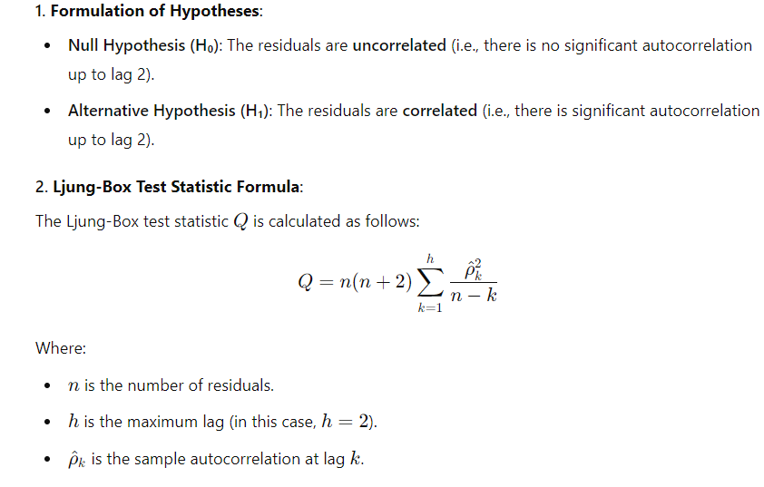
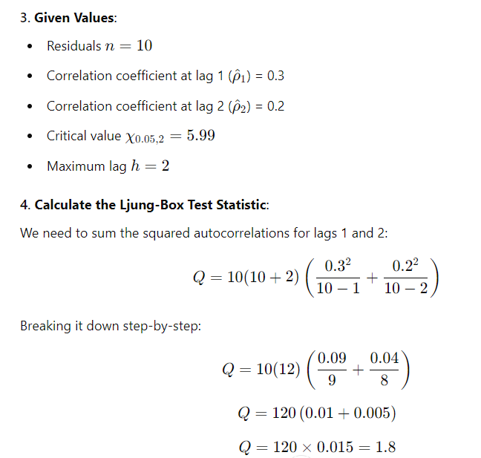
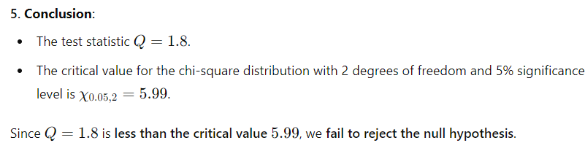
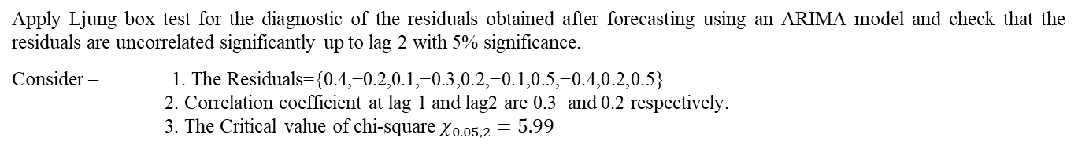
Apply Ljung box test for the diagnostic of the residuals obtained after forecasting using an ARIMA model and check that the residuals are uncorrelated significantly up to lag 2 with 5% significance.
Consider – 1. The Residuals={0.4,−0.2,0.1,−0.3,0.2,−0.1,0.5,−0.4,0.2,0.5}
2. Correlation coefficient at lag 1 and lag2 are 0.3 and 0.2 respectively.
3. The Critical value of chi-square $χ_{0.05,2}=5.99$

